Slide 1
An act modernizing tobacco control
Chapter 133 of the acts of 2019

Slide 2
Amends 18 sections of Massachusetts law
Administration of Government
Executive and Administrative Officers of the Commonwealth
Department of the State Treasurer
Department of Revenue
Department of Transitional Services
Civil Service Retirement Pensions
Taxation
Public Health
Public Welfare
Corporations
Crimes, Punishments and Proceedings in Criminal Cases
Crimes against Public Health
Chapter 270

Slide 3
Notable amendments
Adds nicotine delivery systems (vaping products) to suspension of lottery license for selling tobacco.
Adds vaping products to list of products that cannot be bought with Department of Transitional Assistance benefits.
Requires cessation counseling and FDA approved products to:
Civil service retirement pensions;
Medicaid coverage;
Individual private insurance coverage;
Non-profit individual or group hospital service coverage;
Medical service insurance coverage; and
Health maintenance organization (HMO) insurance coverage.

Slide 4
Notable amendments (continued)
Adds vaping product licensees to those that need to file certain tax returns;
Establishes excise tax on vaping products;
Requires the Department of Public Health to develop regulations concerning:
The sale of tobacco products and vaping products to anyone under 21;
The advertisement of and signage for tobacco products and vaping products;
The operation of adult-only retail tobacco stores and smoking bars; and
Develop penalty/suspension structure.
Violations shall be civil.
Municipalities can pass stricter regulations.
Except regulations that would increase the age to purchase to above 21.

Slide 5
Crimes, punishments and proceedings in criminal cases
Chapter 270, §6(d)
Increases penalties to $1000 for first offense, $2000 for second offense, and $5000 for third and subsequent offenses.
DPH may promulgate regulations to implement this section.
Chapter 270, §28(a-g)
Adds the following definitions:
Characterizing flavor: A distinguishable taste or aroma, other than the taste or aroma of tobacco. . .;
Constituent;
Distinguishable;
Flavored tobacco product: must contain tobacco or nicotine except that vaping products are considered tobacco products regardless of nicotine content;
Flavored product enhancer, etc.

Slide 6
Amendments to tobacco sales law
Prohibits the sale of flavored tobacco products in any retail establishment, online or through any other means to any consumer in the commonwealth, except in smoking bars for on-site consumption only.
Includes menthol.
Online sales to a consumer in another state are permitted.
Public statements or claims that a product has a characterizing flavor is presumptive evidence that the product is flavored.
Cherry, grape, menthol, etc.
Violations are $1000, $2000 and $5000.
Marijuana or marijuana products are not subject to this law.
DPH may enact regulations to implement this law.

Slide 7
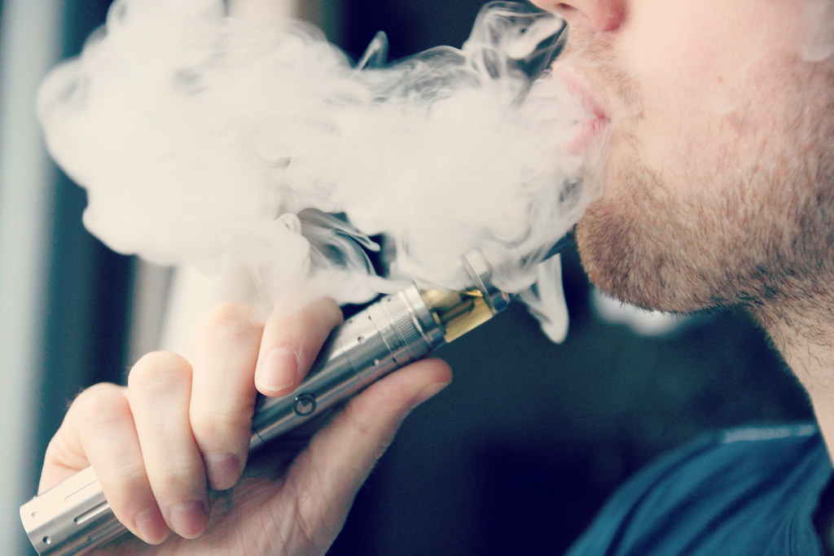
Chapter 270, §29(a-c) New section
Sale of Electronic Delivery Systems
Prohibits the sale of vaping products with a nicotine content greater than 35 mg per ml.
Except in adult-only retail tobacco stores and smoking bars for on-site consumption only.

