Slide 1
MHOA tobacco Law conference
Patricia Henley
Director, Massachusetts Tobacco Cessation and Prevention Program
May 31, 2022

Slide 2
The changing tobacco landscape
2017: JUUL becomes most popular e-cigarette on the market
2007: E-cigarettes first introduced to US market
1996: MA Requirement of Nicotine Disclosure; Cigarette Tax Raised to $0.50/Pack; First Cigar Tax Implemented
2018: MA state law raises the MLSA of tobacco to 21; Also bans the sale of tobacco in pharmacies
1998: Attorney Generals from 46 states, including Massachusetts, sign the Master Settlement Agreement with tobacco companies.
2006: MassHealth provides comprehensive coverage for cessation
2010: MA receives FDA grant to conduct inspections in stores for underage sales
2013: MA Cigarette tax raised to $3.51/Pack
2020: MA state law restricts the sale of all flavored products. Menthol cigarettes no longer to be sold, starting June 2020
Break in trend: BRFSS survey methodology changed in 2011
Note: From 1999-2015 high school tobacco use includes current (past-30-day) use of any cigarettes, cigars, smokeless. From 2015-2019, the definition was expanded to include e-cigarettes.
Data Sources: Adult smoking: Behavioral Risk Factor Surveillance System; Youth Tobacco Use 1997-2017: MYRBS; 2019: HS MYHS
Notes:
Master Settlement Agreement (MSA): The agreement prohibits tobacco advertising to people 18 and younger, requires 25 years of payments to the states, and releases tobacco industry documents to the public.
Nicotine Disclosure: Massachusetts requires cigarette companies to report their products’ ingredients and true nicotine yield ratings to the Massachusetts Department of Public Health.​
40% reduction in adult smoking rate
90% reduction in youth smoking rate (in a school of 1000 kids, 350 kids smoking vs. 40 kids)

Slide 3
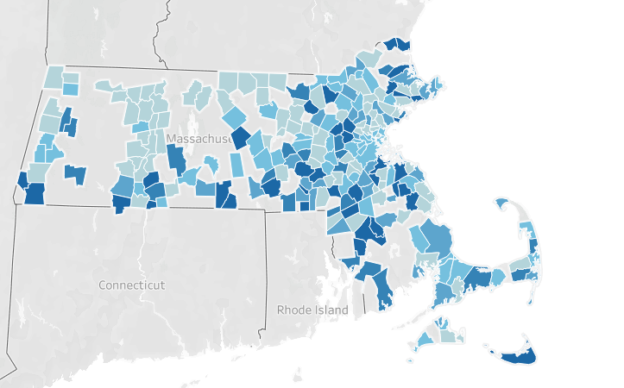
In 2018 - 236 Municipalities with T21

Slide 4
Tobacco Omnibus Bill 2018 2018
Raises age of purchase to 21 with exemption
Prohibits sale of tobacco in pharmacies
Requires smoking cessation service information at point of sale
Includes e-cigarettes in definition of tobacco product
Includes e-cigarettes in smoke-free workplace law
Notes:
Lets talk about the past 4.5 years….in COVID dog years that is a long time – but really – in 4 years we

Slide 5
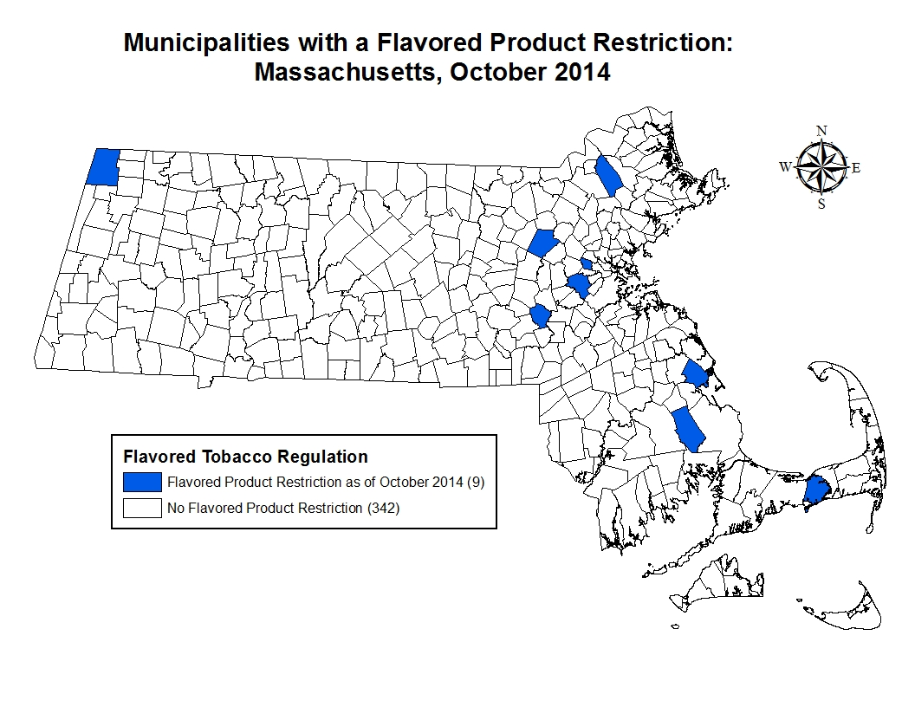
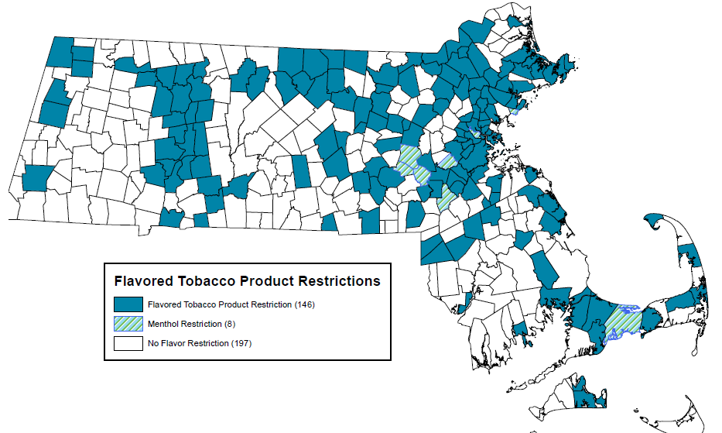
Origin of Flavored Tobacco Restrictions in Massachusetts
In 2014, municipalities in Massachusetts had just starting to adopt flavored tobacco restriction policies. In October 2014, 9 municipalities had adopted a policy.
By June 2019, 154 municipalities in Massachusetts (covering over 60% of the state’s population) had passed a flavored tobacco restriction. 8 of these included menthol
Notes:
The latest flavor regulation data from Massachusetts (July 29, 2019) indicates that 161 communities have passed a flavored tobacco product restriction (including Boston & Worcester) covering 67% of the state’s population. As of July 29, 2019, 13 communities have unexempted mint/menthol from their flavor restrictions. These communities include (Somerville, Ashland, Framingham, Sharon, Barnstable, Norwood, Brookline, Sherborn (only for vape products), Needham, Swampscott, Walpole, Harvard and Chatham). This means that mint/menthol products, alongside other flavored tobacco products, can ONLY be sold in adult-only retailers and are no longer allowed to be sold in youth-accessible retailers such as gas stations, convenience stores, corner stores, grocery stores, etc.

Slide 6
Act to Modernize Tobacco Control 2019
Restricts the sale of all flavored tobacco products, including menthol cigarettes and e-cigarettes, to Adult Only Smoking Bars for on-site consumption only
Restricts the sale of electronic nicotine products with nicotine content greater than 35 mg/ml to Adult Only Tobacco Retail Stores and Smoking Bars
Requires a state license to sell electronic nicotine delivery products
Taxes ENDS products at 75% of wholesale price
Notes:
We got here, municipality by municipality. All of the work done at the local level by our BOH programs educating their munis on local policy options, our statewide TA providing guidance on policy, our Community Partnership programs educating and mobilizing community members about the need for these tobacco strategies and The84, the young people who have educated their decision makers at the local and state level, sharing their experience with how tobacco impacts their lives, the lives of their peers and families.

Slide 7
A comprehensive approach is needed to ensure retailer compliance with the new state law that includes:
Provide training to retailers
Provide technical assistance to municipalities in enforcement and policy adoption
Make signage and educational materials available
Develop key partnerships with other enforcing agencies
Data Support

Slide 8
Provide Retailer Training
Online retail clerk training
In person retail manager training
LBOH specific regulation education visits
Signage and training guides through MA Clearinghouse and Mass.gov
Notes:
Over 10,000 inspections have been completed since the law went into full effect
Distributed x number of signs through the clearinghouse

Slide 9
Notes:
MHOA updated the retailer training with new law, we developed a postcard to be mailed to all retailers . Available at clearinghoue

Slide 10
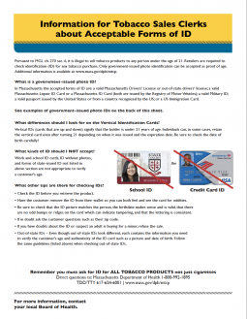
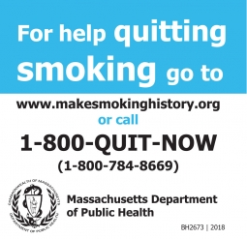
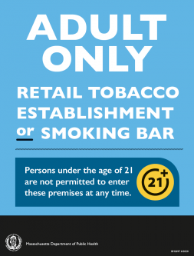
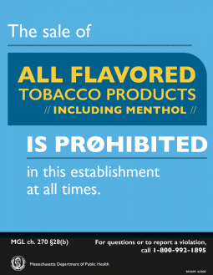
Make materials available

Slide 11
Provide technical assistance and training for enforcement
How to conduct an inspections
How to conduct compliance checks with youth
Protocols and procedures for conducting inspections and recording and maintaining evidence
Youth compliance check training for underage buyers
Include in-person “ride along” opportunities for both adult inspectors and youth buyers
Notes:
MTCP funds the technical assistance and training for enforcement activities and policy guidance. We provide training in how to conduct inspections and checks.
MHOA

Slide 12
Tools for Tobacco Sales Law Implementation
MTCP Complaint Line 1-800-992-1895
2019 Tobacco Control Law | Mass.gov
Retailer Guidance Letters
Retailer and Signage Charts
Retailer Inspection form
Signage
www.mass.gov/maclearinghouse - order free of charge
DOR Complaints
DOR Illegal Tobacco Task Force | Mass.gov
Notes:
The complaint line – Chris monitors
We have updated retailer guidance letters on the MTCP website, as I said there is signage available for free, and I am going to talk next about DOR
The next workshop will go into more detail about tools for enforcement, but I’d like to highlight what is currently available through MTCP. The Complaint line is key to hearing from the public about potential violations. We will follow the same protocol we use with smoke-free workplace law violations and the recent vaping ban. Complaints will be forwarded on to local boards of health for follow up, if you are unable to do the follow up or need further assistance with particular retailers, our DPH inspectors will assist.
Education is key to assuring compliance. Tools such as signage for retailers can help
signage is available both on the mass.gov/newtobaccolaw website and at the mass clearinghouse.
The updated charts of what can be sold where and signage requirements will be available on the newtobaccolaw website keep it close – it will help!
Also available will be signage in other languages. Very soon these signs will be available for download from the clearinghouse.
Finally, we have developed a retail inspection form to help you with your inspection of local retail establishments. This is a paper form that helps you track the type of product for sale in each establishment, the presence of required signage, and other information to help you keep track of the retail environment in your city or town. This is for your use, but is not required and you do not need to complete and submit to DPH

Slide 13
Key partnerships with other agencies
Regular meetings with other enforcement agencies
Department of Revenue
Attorney General’s Office
Department of Fire Safety
Participate in state Illegal Tobacco Task Force
State Police
Executive Office of Public Safety
Attorney General’s Office
Department of Revenue
Notes:
Another part of the comprehensive approach we take is developiong key partnerships. We have been working closely with the DOR. Our FDA enforcement team is regular communication. The DOR notifies us if they find a retailer in violation. In addition, our funded BOH and inspectors notify DOR if they

Slide 14
Provide data collection support
Point of Sale Toolkit (POST)
Collect inspection and compliance check data in one system
Mobile app for real time data collection
Pricing Survey
Collect data on specific products and prices
Provide training and assistance to use system
Notes:
The final component of a comprehensive approach fo the implementation of the law is DATA. You all have been inputting the inspecito and check data, we do pricing surve
Evaluating the effectiveness of this law is vital

Slide 15
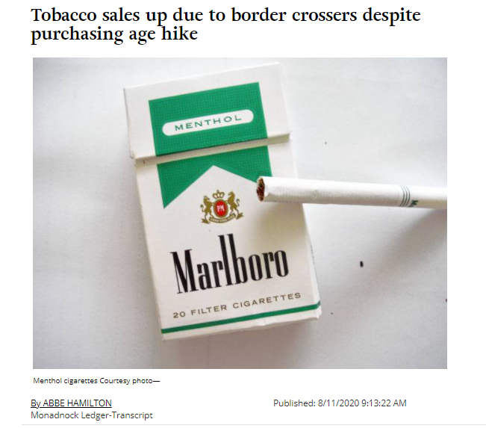
Why is it Important to Evaluate the Law?
1. First comprehensive evaluation of a menthol law in the US (prior studies have been conducted in Canada). MA is a leader in contributing to the national evidence base on point-of-sale policy.
2. Generating evidence to debunk myths and support policy movement
Monadnock Ledger-Transcript

Slide 16
Key Evaluation Questions
Awareness/
Perceptions: Are adults aware of the law? Do they support it?
Retail Environment: Has the new law decreased sales and availability of menthol and other flavored tobacco? How has it impacted overall tobacco sales?
Tobacco Use:
Has the new law decreased menthol and other flavored tobacco use among youth and adults? Has it decreased tobacco use overall?
Cessation: Has the new law increased rates of tobacco treatment and use of evidence-based resources?
Racial Equity: Has the new law decreased sales/availability of menthol and other flavored tobacco,
decreased tobacco use, and increased rates of tobacco treatment in communities of color?

Slide 17
Evaluating the impact of local and state laws
Short-Term Impact of a Flavored Tobacco Restriction: Changes in Youth Tobacco Use in a Massachusetts Community (ft. in FDA scientific review)
https://www.ajpmonline.org/article/S0749-3797(19)30348-4/abstract
Longer-term impact of the flavored tobacco restriction in two Massachusetts communities: a mixed-methods study
https://academic.oup.com/ntr/article-abstract/23/11/1928/6316182?redirectedFrom=fulltext
The association between neighborhood racial composition and menthol cigarette pricing in Boston, MA
https://www.sciencedirect.com/science/article/abs/pii/S1353829219303004?via%3Dihub
Single Cigar Price and Availability in Communities With and Without a Cigar Packaging and Pricing Regulation
https://www.ncbi.nlm.nih.gov/pmc/articles/PMC6638583/
Impact of flavoured tobacco restriction policies on flavoured product availability in Massachusetts
https://tobaccocontrol.bmj.com/content/29/2/175 March 2020
Evaluating tobacco retailer experience and compliance with a flavoured tobacco product restriction in Boston, Massachusetts: impact on product availability, advertisement and consumer demand
https://tobaccocontrol.bmj.com/content/29/e1/e71 2019
Notes:
Local and State Policy Action Taken in the United States to Address the Emergence of E-Cigarettes and Vaping: A Scoping Review of Literature
https://journals.sagepub.com/doi/abs/10.1177/1524839920963691
Implementation and evaluation of the public health emergency response to the 2019 outbreak of e-cigarette and vaping product use-associated lung injury in Massachusetts, USA
https://pubmed.ncbi.nlm.nih.gov/35131680/
Perceptions of vape product restrictions among adult vapers
https://tobaccocontrol.bmj.com/content/early/2021/01/15/tobaccocontrol-2020-056185.info

Slide 18
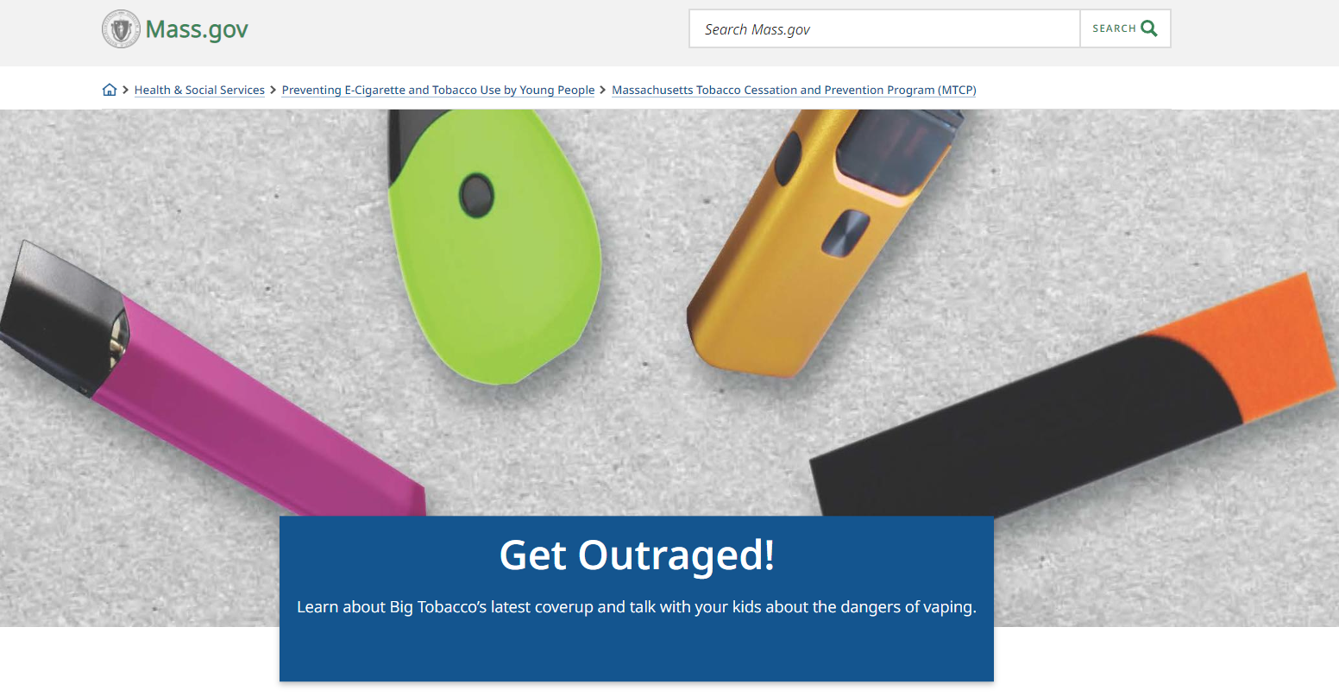
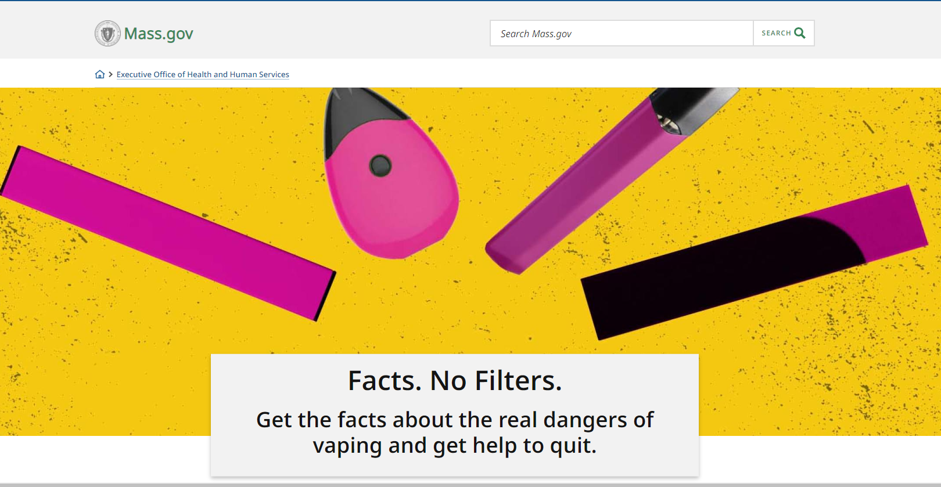
Vaping Education Support for Adults and Youth
GetOutRaged.org
Mass.gov/vaping
Notes:
Finally, MTCP and DPH continue to work to provide resources for parents, schools, medical providers, to educate themselves and the young people they care about.
We have a youth campaign that includes the website mass.gov/vaping. It has the resources for quitting, factual information for youth – that they have asked for –
The more we all know the more likely the industry tactics will fall flat.
Both of the vaping campaigns and a campaign for cessation are in process and will begin to air online by mid-Fall
Thank you for all of the work that you do to protect the health of youth and adults in Massachusetts.

Slide 19
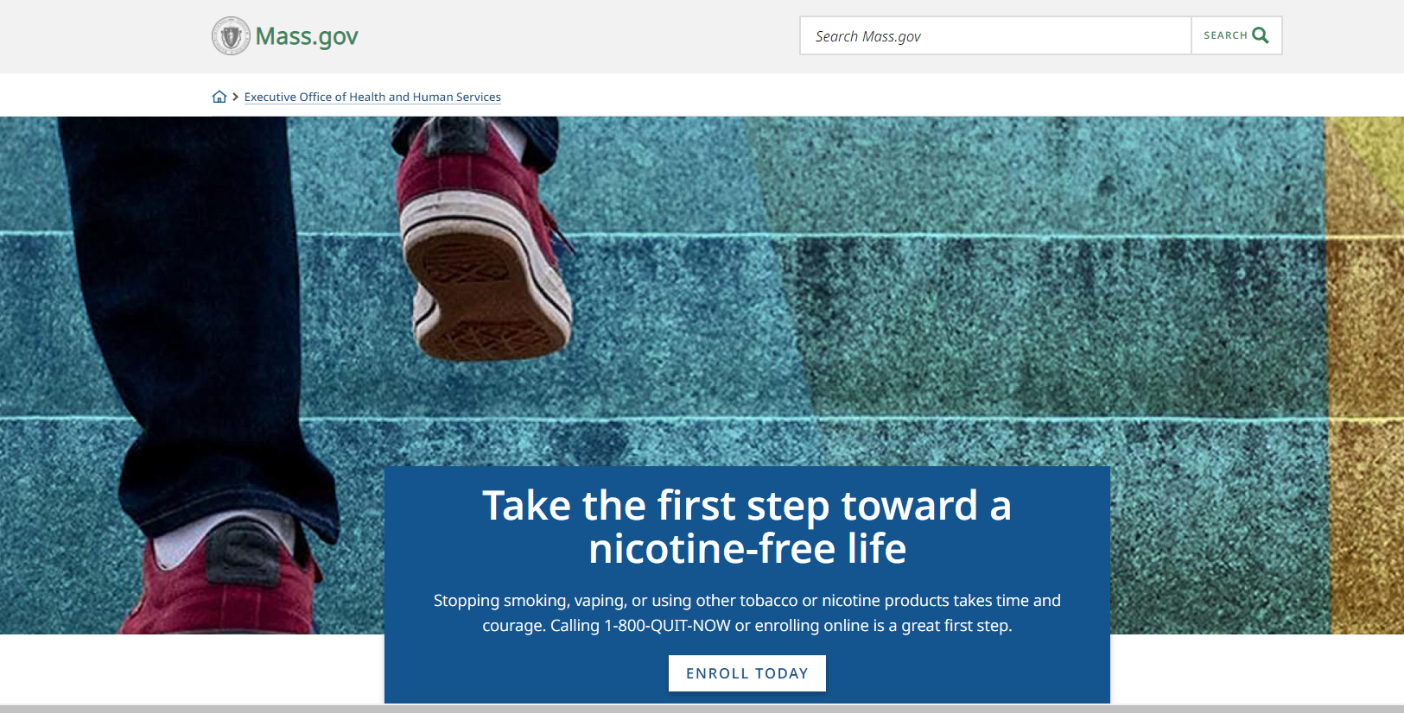
Mass.gov/quitting

Slide 20
Cessation Support
Massachusetts Quitline at 1-800-QUIT-NOW (1-800-784-8669)
provides counseling and 8 weeks of NRT
Currently has an incentive program for users of menthol tobacco
This is Quitting powered by truth® is a free and confidential texting program for young people who vape. Young people can text “VapeFreeMass” to 88709.
My Life, My Quit™ has youth coach specialists trained to help young people by phone or text. Young people can call or text "Start My Quit" to 855-891-9989 for free and confidential help or visit mylifemyquit.com to sign up online.
Notes:
WE can’t talk about tobacco sales laws or any tobacco interventions without acknowledging the need fo support those who are currently addicted to nicotine and tobacco products. MTCP provides cessation support to both adults and youth through these programs. In addition, MTCP is working with our School Health program to incorporate nicotine into the SBIRT interventions that are taking place in the schools, we work with community health centers to connect them to online referrals to the Quitline and provide community education about these resources.

Slide 21
Questions contact:
Patti Henley,
Director, Massachusetts Tobacco Cessation and Prevention Program
Patricia.henley@mass.gov
P: 857-243-0871

